Slide 1

Selenium Automation

Slide 2
What is Selenium
Selenium is free-open-source automation framework used to validate web application across different browser and platform.
We can use multiple programming languages like Java, C#, Python, Ruby..etc to create Selenium Test scripts.
Testing done using the selenium testing tool is usually referred as Selenium Testing.

Slide 3
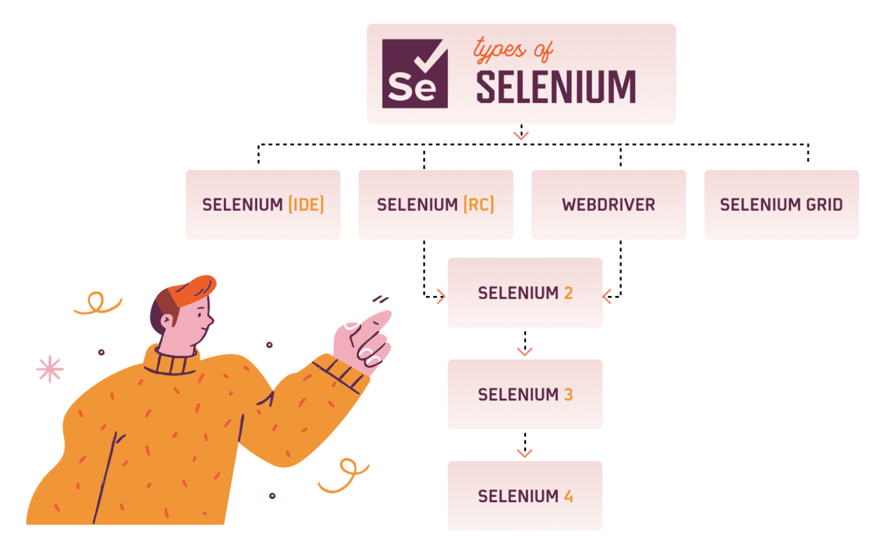
Selenium Components
Selenium Integrated Development Environment(IDE).
Selenium Remote Control(RC).
WebDriver
Selenium Gride

Slide 4
Who developed Selenium
Selenium was created by Jason Huggins in 2004. An engineer at ThoughtWorks, he was working on a web application that required frequent testing.
Having realized that their application required repetitious Manual Testing was become increasingly inefficient, he created a JavaScript that automatically control the browser action’s and named as “JavaScriptTestRunner”.
Then he made as open sources and then later the name changed to Selenium Core.

Slide 5
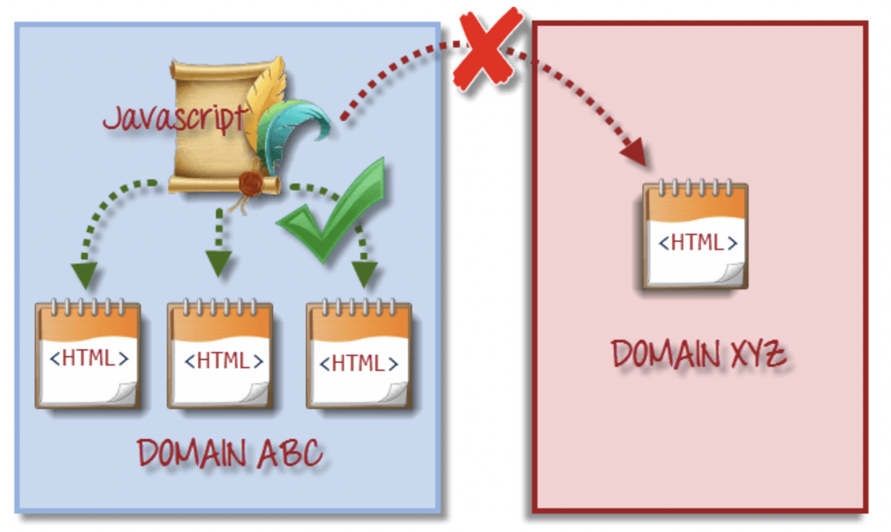
Selenium Core
Disadvantages of Selenium Core
Some origin policy prohibits JavaScript code from accessing the web elements from a domain that is different from where its is launched.
Example, the HTML code in www.google.com use a JavaScript program “randomScript.js”. The same origin policy will only allow randomscript.js to the pages with www.google.com/mail, www.google.com/login or www.google.com/signup.
However, it cannot access pages from different sites such as yahoo.com/search because they belong to different domain.

Slide 6
WebDriver – Selenium Component
WebDriver is one of the Selenium Component.
It’s a collection of classes and methods that performance certain actions.
Eg. Selenium supports multiple browsers like, Firefox, Chrome, Edge, Opera, Safari.
Each browser has the classes like, FirefoxDriver(), ChromeDriver(), EdgeDriver(),..
WebDriver is also an API.

Slide 7
What is an API?
API is nothing but,
“A” Application is the presentation layer.
“P” Programming is the business layer/logic.
“I” Interface is acting like interactive between the presentation and backend layer.
Business layer divided into multiple classes, which are called as API’s.
GUI/UI Presentation Layer
Request
Application / Web service Business Layer
Request
Database
Backend Layer
Response
Response
GUI Testing
API Testing
Database Testing

Slide 8
WebDriver - API
WebDriver is an API(Application Programming Interface).
Application Code
WebDriver
Browsers(Chrome, Edge, Firefox)
public void action1(){}
public void action2(){}
driver.action1()
driver.actions2()
AUT(Application Under Test)

Slide 9
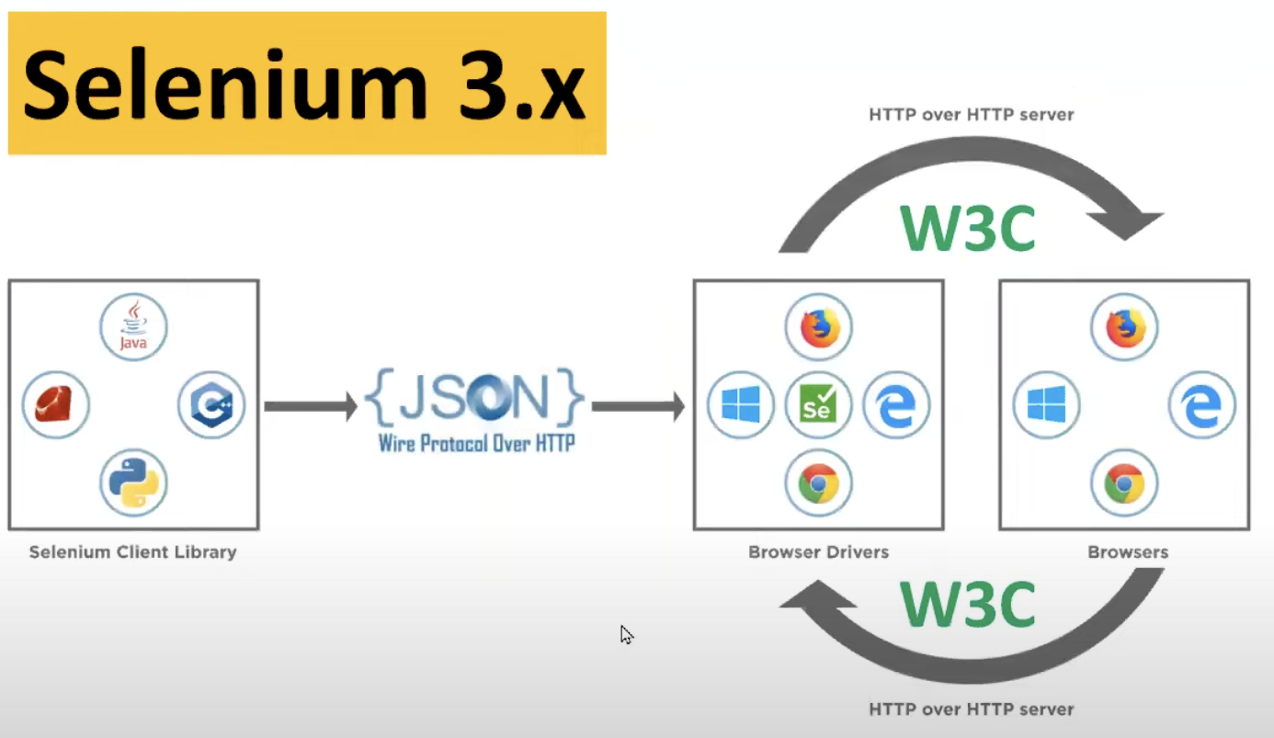
Selenium 3.x - Architecture
Selenium client library has been created
for different language like Java, C++, Ruby,
python, JavaScript.
Library is nothing but collection of
classes and methods developed based
on their languages.
Using JSON protocol to connect between from the class library and the browser.
JSON is like a common language between the class library and the W3C(World Wide Web Consortium).

Slide 10
Disadvantages – Selenium 3.x
Inconsistence due to two different protocols JSON and W3C.
Some instability issues due to two different protocols JSON and W3C.

Slide 11
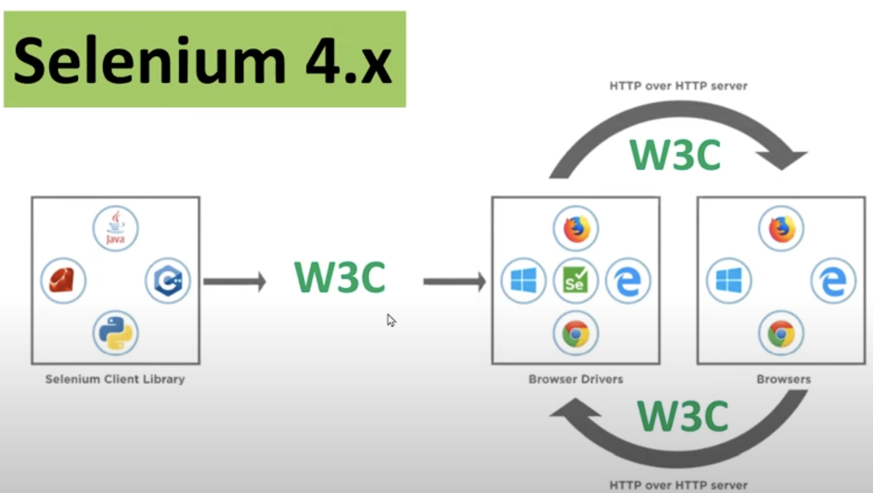
Selenium 4.x - Architecture
JSON protocol is replaced with W3C,
in order to reduce the inconsistency.
Now the client library able to
Communicate with W3C.
Increased the stability issues.

Slide 12
Drivers - Link
Below drivers can be downloaded based on the browser need.
Chrome: | https://chromedriver.chromium.org/downloads
Edge: | https://developer.microsoft.com/en-us/microsoft-edge/tools/webdriver/
Firefox: | https://github.com/mozilla/geckodriver/releases
Safari: | https://webkit.org/blog/6900/webdriver-support-in-safari-10/

Slide 13
Test with WebDriver
Launch Browser
WebDriver driver = new ChromeDriver();

Slide 14
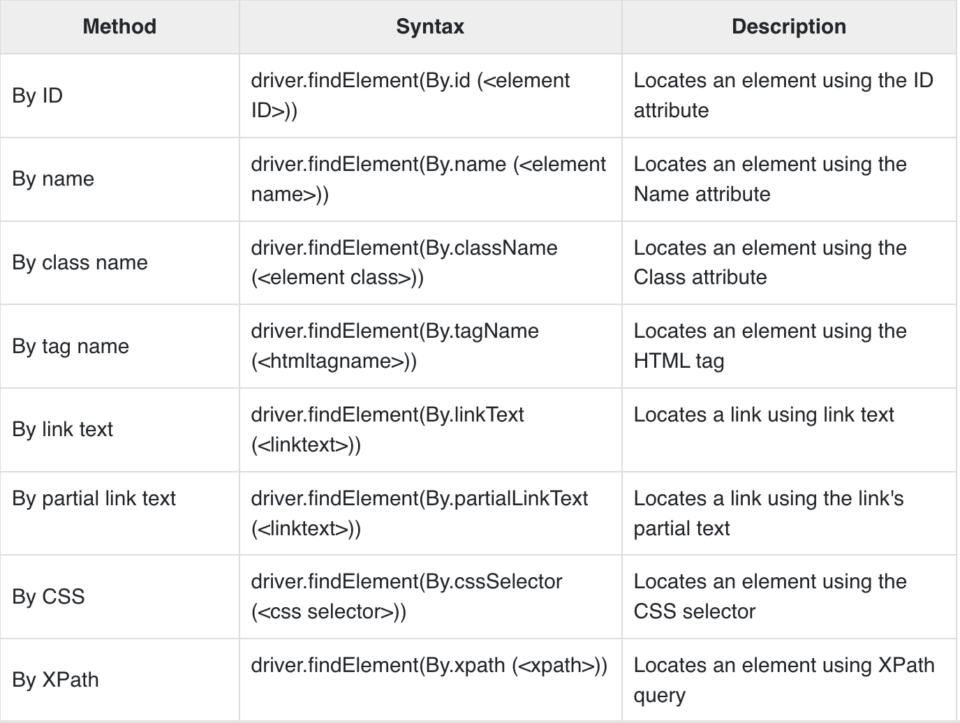
Locators - Selenium

Slide 15
JUnit & TestNG
JUnit is framework is a Java framework that is used frequently in the testing process.
JUnit has the limited features.
TestNG is framework that makes it easier to execute the software test in the Java programming language.
TestNG has advance features.
Eg.
@BeforeSuite
public void precondition(){
System.setProperty(“webdriver.chrome.driver”,””);
}
@BeforeTest
Public void conditionA(){
….
}
@Test(expected = ArithmethicException.class) //annotation
Public void launch(){
WebDriver driver = new ChromeDriver();
driver.get(“”);
}

Slide 16
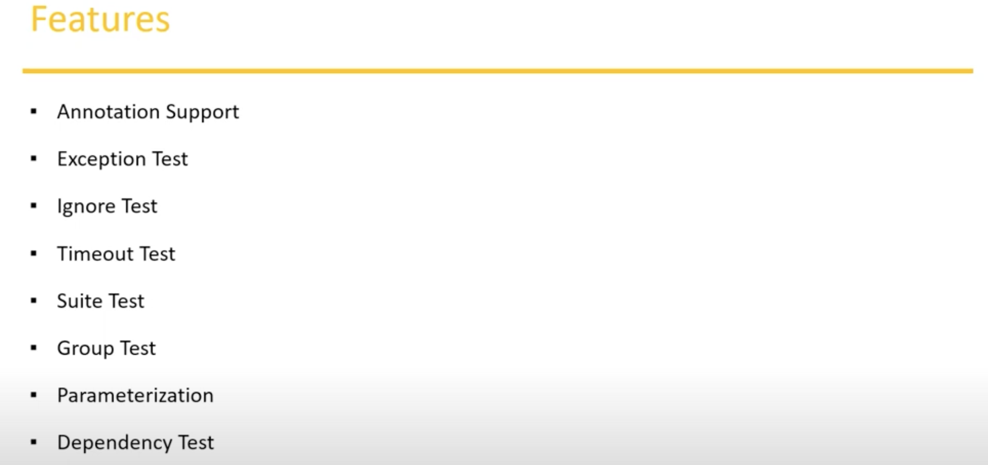
Features of JUnit & TestNG

Slide 17
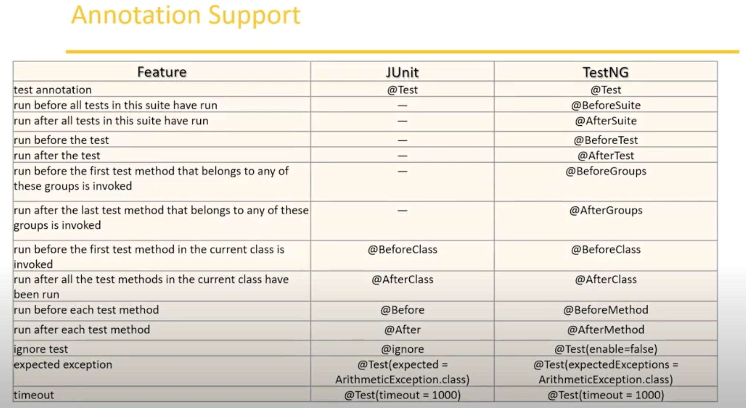
Annotation Supports

Slide 18
JUnit & TestNG - @BeforeClass
JUnit for @BeforeClass, we need to declare the method as static.
Eg.
@BeforeClass
public static void preCondition(){
//..statement
}
TestNG for @BeforeClass, we don’t need to declare the method as static
Eg.
@BeforeClass
public void preCondition(){
//..statements
}

Slide 19
JUnit & TestNG – Exception Test
JUnit for @Test, exception is handled as,
Eg.
@Test(expected = ArithmeticException.class)
public static void preCondition(){
int I = 1/0;
}
TestNG for @Test, exception is handled as
Eg.
@Test(expectedExceptions = ArithmeticException.class)
public void preCondition(){
int I = 1/0;
}

Slide 20
JUnit & TestNG – Ignore Test
JUnit for @Test, to skip the test case,
Eg.
@Ignore(“Not ready to run, Bug Card - 7756”)
@Test(expected = ArithmeticException.class)
public static void preCondition(){
int I = 1/0;
}
TestNG for @Test, exception is handled as
Eg.
@Test(enabled = false)
public void preCondition(){
int I = 1/0;
}

Slide 21
JUnit & TestNG – Time Test
JUnit for @Test, for the timeout, If it exceeds more the give time interval.
Eg.
@Test(timeout =1000)
public static void preCondition(){
while(true);
}
TestNG for @Test, for the timeout, If it exceeds more the give time interval.
Eg.
@Test(timeout =1000)
public static void preCondition(){
while(true);
}

Slide 22
JUnit & TestNG – Suite Test
JUnit for Suite test would be
Eg.
@RunWith(Suite.class)
@Suite.SuiteClasses({
JunitTest1.class,
JunitTest.class})
public class JunitTest5{
}
TestNG for Suite test would be, testng.xml file and with below steps,
Eg.
<!DOCTYPE suite SYSTEM “http://beust.com/testing/testing-1.0.dtd>
<suite name=“My test suite”>
<test name=“testing”>
<classes>
<class name =“com.fsecure.demo.testing.TestNg1”/>
<class name =“com.fsecure.demo.testing.TestNg3”/>
<class name =“com.fsecure.demo.testing.TestNg2”/>
</classes>
</test>
</suite>

Slide 23
JUnit – Test Case Prioritized
By using Junit Jupiter package we can achieve the test case prioritized.
Eg: import org.junit.jupiter.api.MethodOrderer
@TestMethodOrder(MethodOrderer.OrderAnnotation.class)
public class MethodOrderTest {
@Test
void test0() {
assertEquals(2, 1 + 1); }
@Test
@Order(3) //by using the @Order annotation we can prioritized the testcases.
void test1() {
assertEquals(2, 1 + 1); }

Slide 24
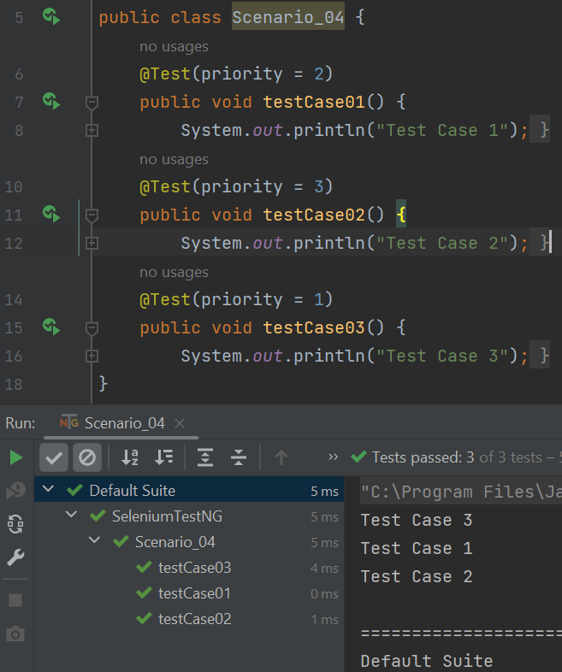
TestNG – Test Case Prioritized
By using the TestNG, test case can be
prioritized.
Eg: @Test(priority=1)

Slide 25
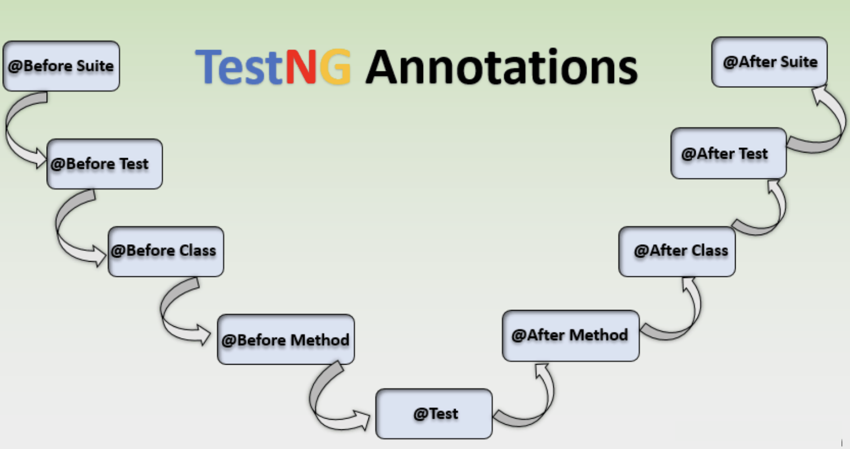
TestNG Annotations
TestNG is an automation framework in which NG stands for
”Next Generation”.
TestNG overcomes the disadvantages of Junit and is
designed to make end-to-end testing.
Why use of TestNG in Selenium?
Default selenium tests do not generate a proper format for the test results. Using the TestNG we can achieve it.
What is an Annotations?
Annotation is the form of metadata that can be added to the java source code.

Slide 26
Different Annotation - TestNG
@BeforeSuite, @AfterSuite
@BeforeTest, @AfterTest
@BeforeClass, @AfterClass
@BeforeMethod, @AfterMethod
@Test
@DataProvider
@Parameters
@Factory
@Listener
@ignore

Slide 27
Groups - TestNG
TestNG groups allow you to perform groupings of different test methods.
Grouping of test methods is required when we want to access the methods from the different classes.
Groups are specified in the testng.xml with <group> tag. Groups can be specified the suite or test tag in the testng.xml file.
If the <group> tag is specified inside the <suite> tag then its applied to all <test> tags of the xml file.
If the <group> tag is specified inside the <test> tag then its applied to the particular <test> tag.

Slide 28
TakeScreenShot - Selenium
A Screenshot in selenium webdriver is used for bug analysis. Selenium webdriver will automatically take screenshots during the execution.
To capture screenshot we need to use a interface TakeScreenshot and using that method name as getScreenshotAs()
Eg.
TakeScreenshot screenshot = ((TakeScreenshot)driver);
File sourceFile = screenshot.getScreenshotAs(OutputType.FILE);
FileUtils.copyFile(sourceFile, new File(“screenshot.png”);

Slide 29
TestNG - Reports
TestNG reports are default HTML reports that generated once the test cases are executed using TestNG.
The reports helps to identify the information about the test cases and the status of the project.
TestNG reports in Selenium have three methods passTest, failTest and skipTest.

Slide 30
Parameters - TestNG
@Parameters is in TestNG is used to pass the value to the functions.
Eg. If we want to run a different functions with the same value.
Parameters is used to pass the value during the runtime.
Two different ways of passing the value,
With testng.xml
With Data providers
Syntax,
@Parameters({a,b})

Slide 31
Data Provider - TestNG
@DataProvider annotations helps us to pass different value for a same function.
DataProvider have single attribute, which is its name.
Data Provider are not declared on top of the functions, but have the separate methods.
If the Data Provider name is not declared, then the method name will take it as data provider as default.
Eg. @DataProvider(name=“dataProvider-testCase01”)

Slide 32
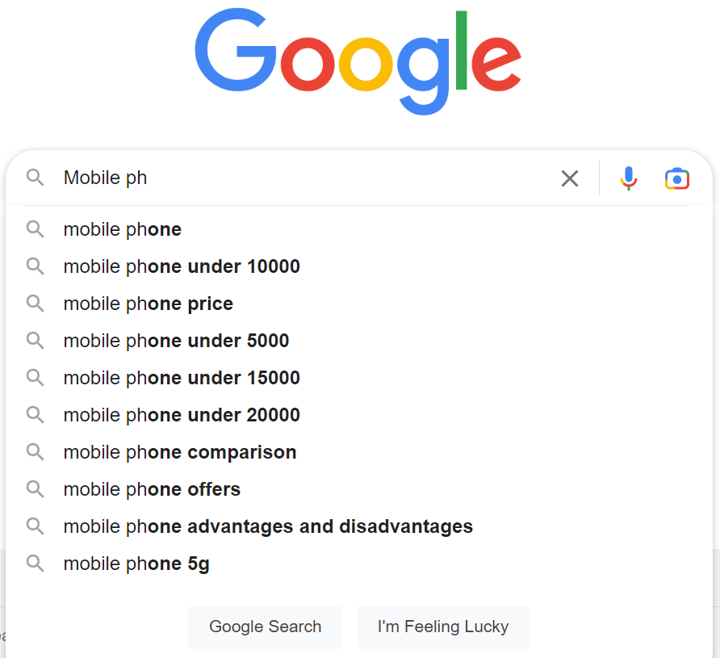
Handling Auto Suggestion
Auto suggestions can be seen in the search box.
Eg, In the Google search If we type of the mobile phone,

Slide 33
Handling Dropdown List
Different ways of handling dropdown in Selenium,
How to select an option from drop-down.
How to store dropdown options in a list.
How to deselect an option from drop-down.

Slide 34
File uploading using - AutoIt
AutoIt is freeware scripting language designed for automating window GUI and general scripting.
It uses a combination of mouse movement, keystrokes and window control manipulation to automate a task which is not possible by selenium webdriver.
Why AutoIt
Selenium is an open source tool and is designed to automate the webbased application, but to handle the window GUI and Non-HTML popup, AutoIt is required.
Link -> https://www.autoitscript.com/site/autoit/downloads/

Slide 35
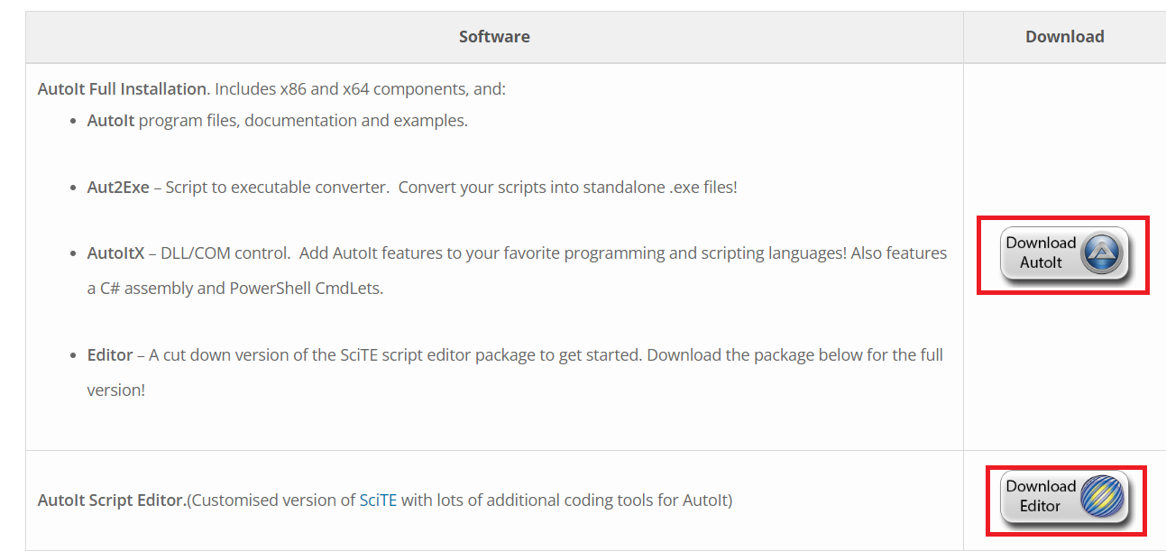
Download & Install- AutoIt

Slide 36
Scripting
Open the script editor.
ControlFocus() => To focus the window.
ControlSetText() => To give the file path.
ControlClick() => To click on open button.
Note:
controlID = Class + Instance (Edit1)

Slide 37
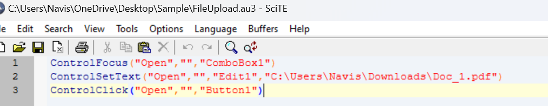
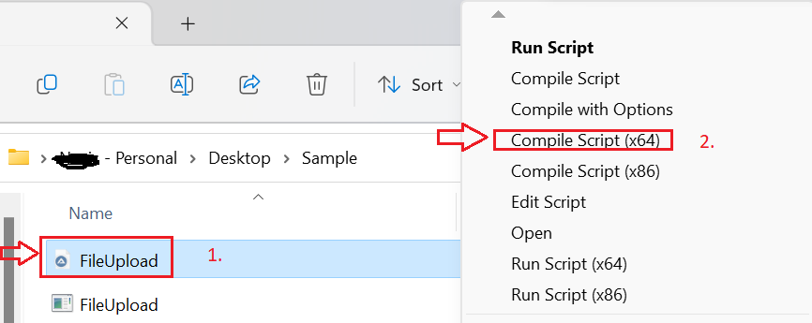
Convert to exe
Once the script is done, save in specific path.
Convert to exe file as below,

Slide 38
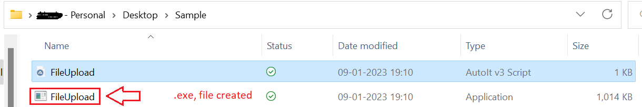
Execute file
Execute file will be created.

Slide 39
Drag and Drop – Selenium Actions Class
Some web application has feature to drag and drop the elements and that can be automated using the Selenium Webdriver.
It can be achieved using the Actions class.
Eg:
Actions.dragAndDrop(Sourcelocator, Destinationlocator);

Slide 40
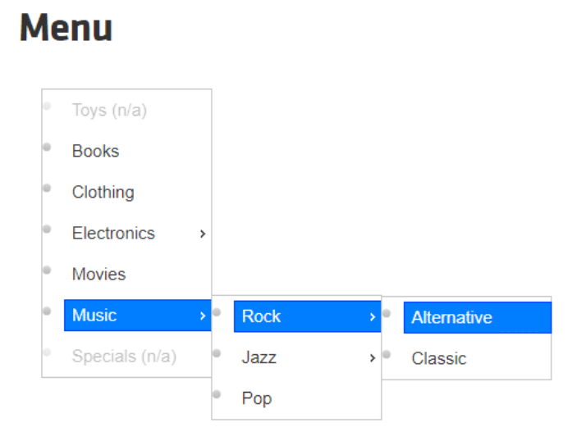
Mouse Hover – Selenium Actions Class
Mouse Hover and Keyboards event handled by using the Actions class in Selenium.
In automation, many times it is required to perform some action on the element which get visible only when mouse hover on some other element.
For this, mouse cursor needs to be placed over an element.
Using the Actions class provides the moveToElement(), the action can be performed.
Some common methods - https://www.selenium.dev/selenium/docs/api/java/org/openqa/selenium/interactions/Actions.html

Slide 41
Keyboard Events – Selenium Actions Class
Selenium provides and Actions class to handle the Keyboard events.
Eg. In the Google search, to search for a location “Bangalore” and press the Enter key, so that we see the result queries.
To simulate pressing the ENTER key using the Actions class is possible.
The Keyboard event describes users interactions with keyboard when the user press single or multiple keys, keyboard event generates.
Selenium provides three different ways of handling the Keyboard events,
Automate Keyboards event using the sendKeys() method of web element class.
Automate Keyboards event using the Robot Class.
Automate Keyboards event using the Actions Class.

Slide 42
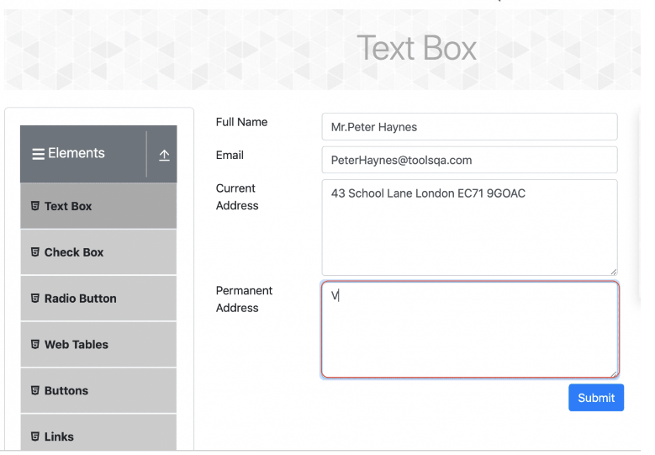
Process Keyboard Event using the sendKeys()
When we tried use the sendKeys() method to copy and paste any content below screenshots that the value is not able to paste it.
To avoid this Actions class come
into picture.
Three different methods provided from the
Actions class,
sendKeys(CharSequence… KeysToSend)
keyDown(CharSequence key)
keyUp(CharSequence key)

Slide 43
Multiple browser
How to run the test in the multiple browser.
How to run the test in the multiple browser parallel.

